Slide 1
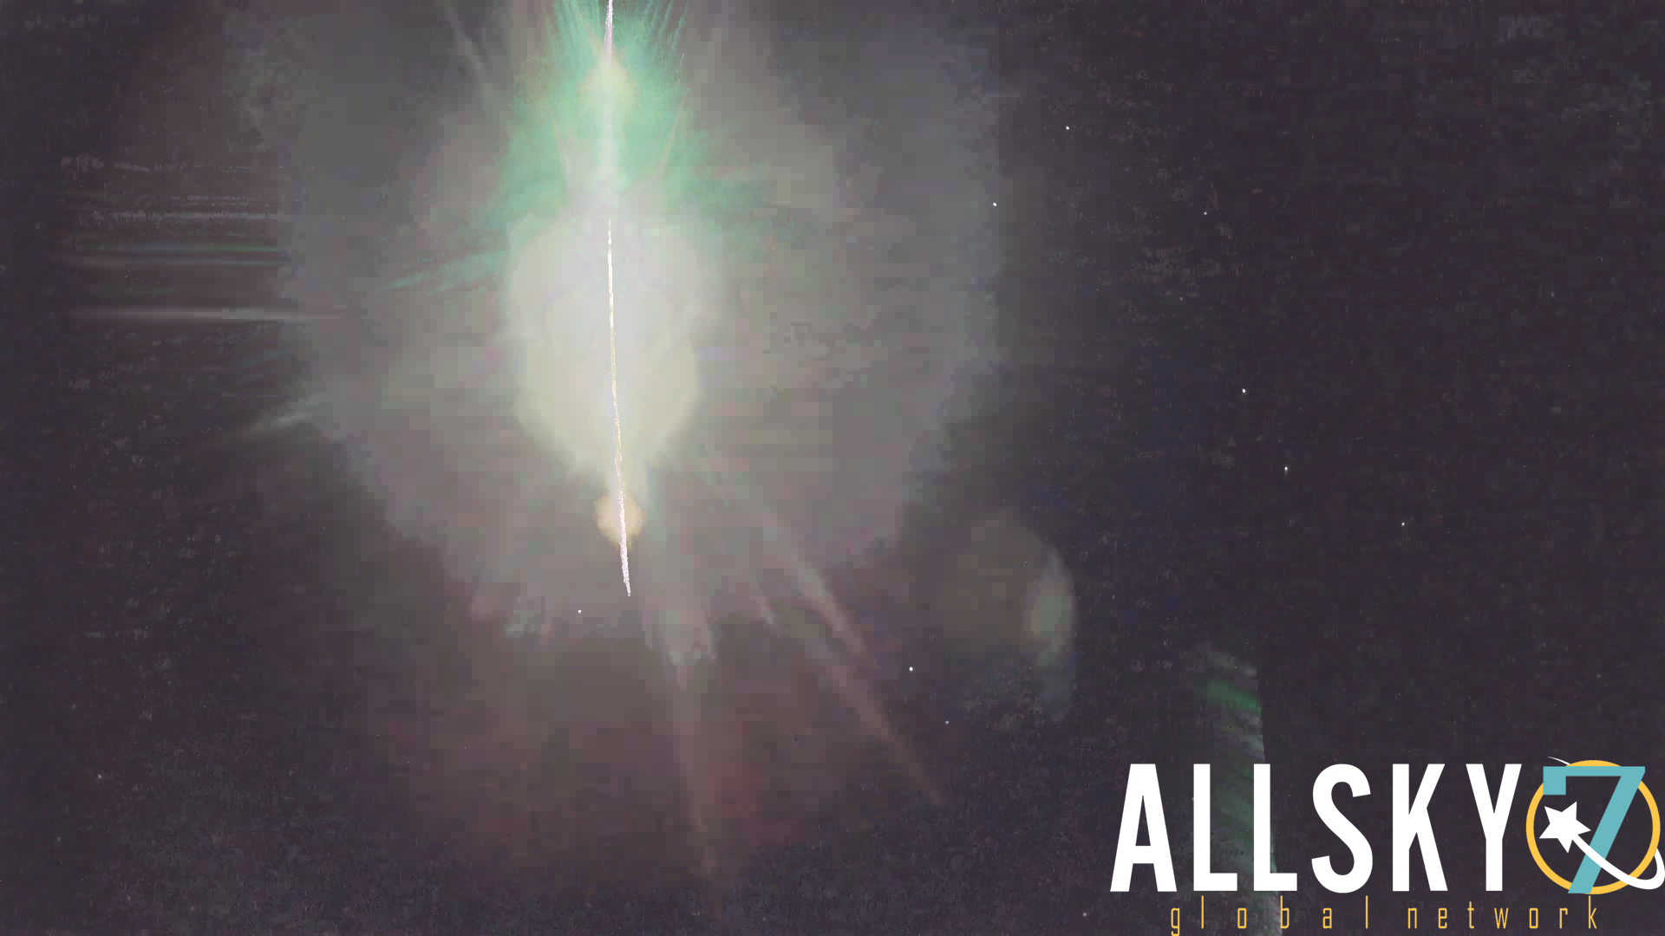
2024 BX1 and the Ribbeck Meteorite Fall (Part 1)
IMC 2024, Kutná Hora, Czech Republic, 19.-22.09.2024
Andreas Möller, Sirko Molau
Arbeitskreis Meteore e.V.

Slide 2
Overview
Part 1
The Discovery
The Alerting
The Observation
The Organization

Slide 3
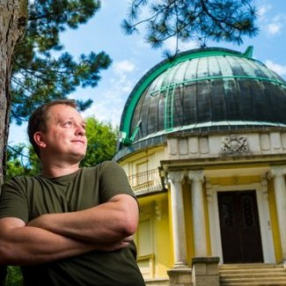
The Discovery
20.01.24, 22:48 The Hungarian astronomer Krisztián Sárneczky discovers the asteroid Sar2736 with the 60 cm Schmidt Telescope in Piszkéstető.
The asteroid was a diameter of less than 1m (therefor a meteoroid by definition) and an impact probability of ~7% at first.
In the next few hours, 180 more observations world-wide are obtained from the object, which gets the official designation 2024 BX1.

Slide 4
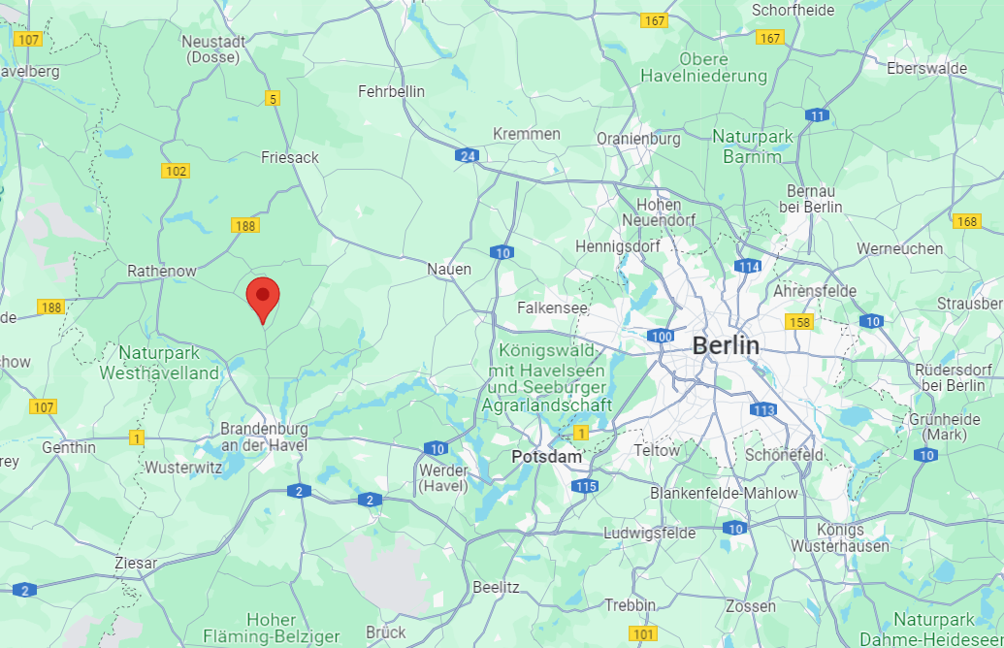
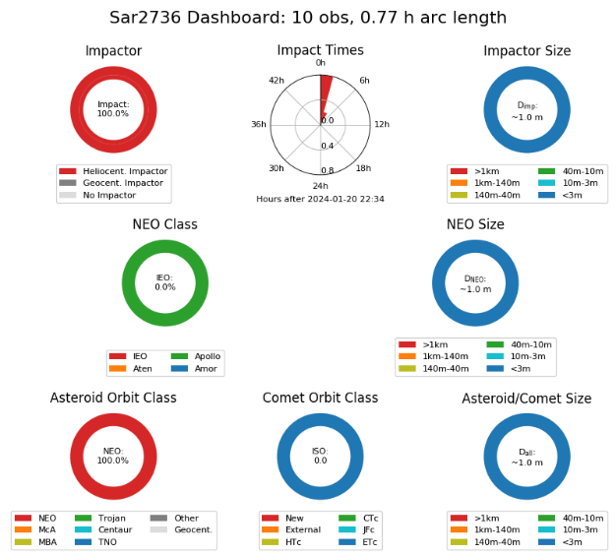
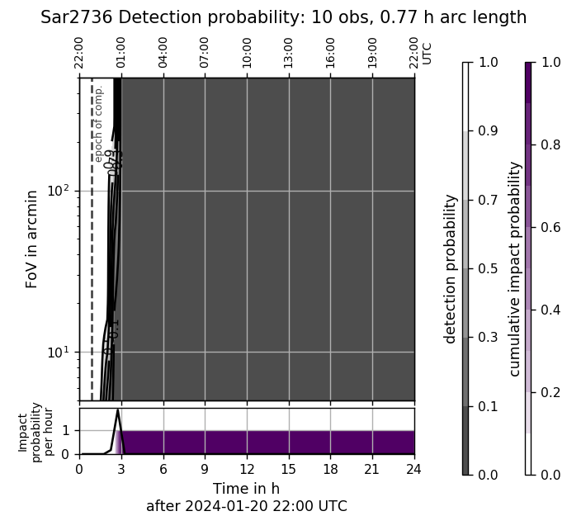
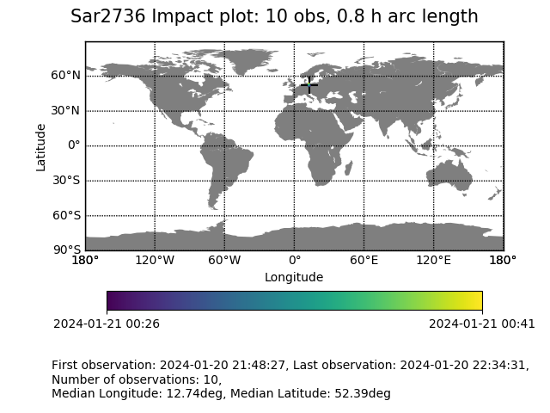
The Alerting
20.01.24, 23:53 Meerkat, the ESA early impact warning system, deliveres an alert.
The impact probability for Jan 21, 01:32, 2024 at 12.74° E / 52.39° N (west of Berlin) is 100%!

Slide 5
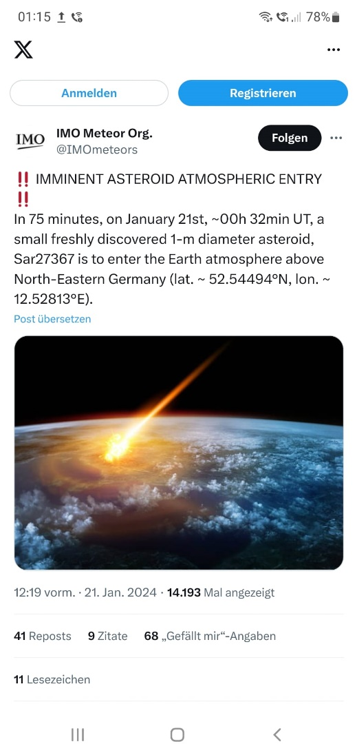
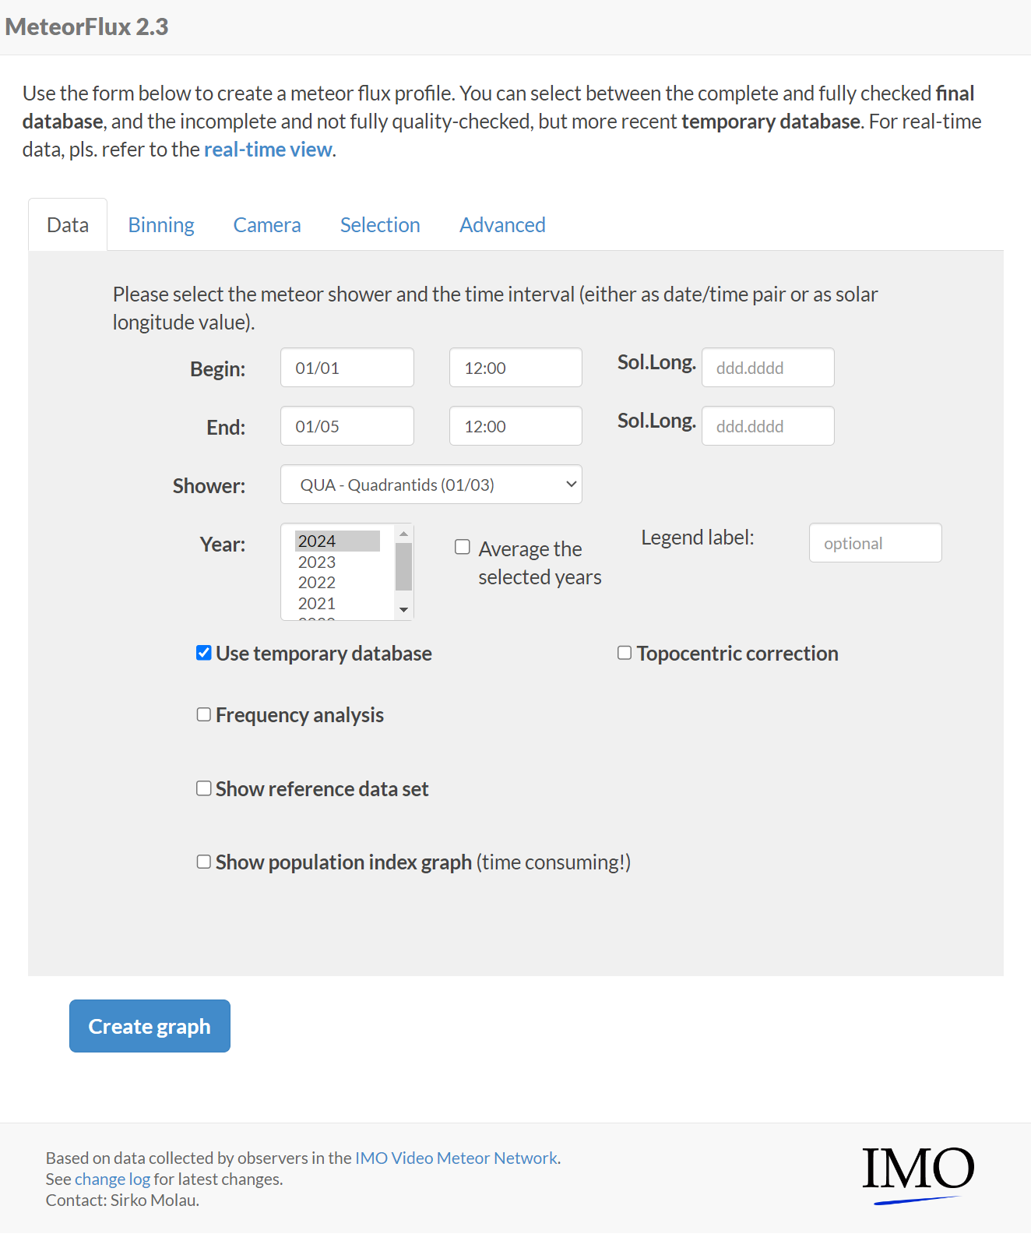
The Alerting
21.01.24, 00:19 The news spreads quickly in different social media, e.g. at the twitter account of IMO.
But who is still awake at that time?
21.01.24, 00:30 In preparation of the AKM meeting, I have been programming highly concentrated on the MeteorFlux for hours, avoiding any disturbance.

Slide 6
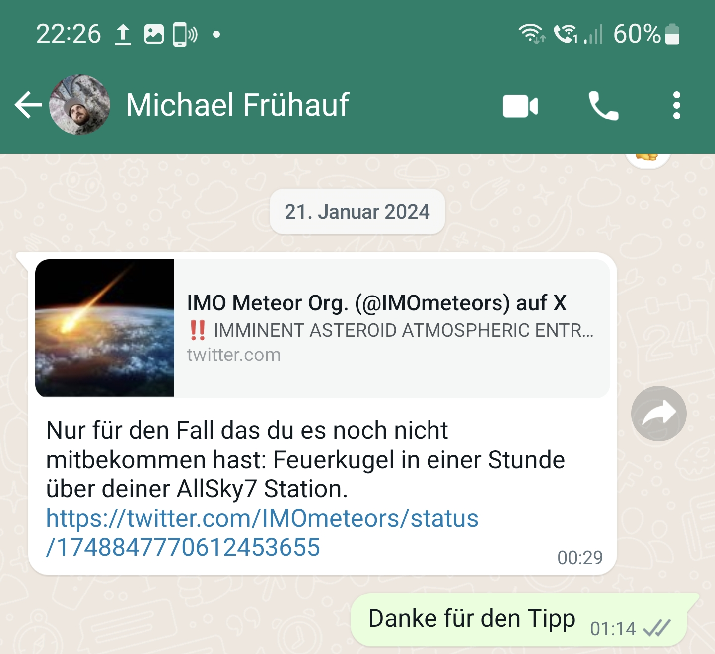
The Alerting
21.01.24, 00:35 Two phone calls from an unknown American (!) number are ignored.
21.01.24, 00:40 Also the personal e-mail alert by P. Jenniskens remains unread.
21.01.24, 01:14 Yet another WhatsApp! ☹
I look annoyed at my smartphone and read the message, which M. Frühauf had sent me at 00:29.
21.01.24, 01:15 I‘m petrified!
Just 17 min left! What shall I do first?
Whom else to alarm?

Slide 7
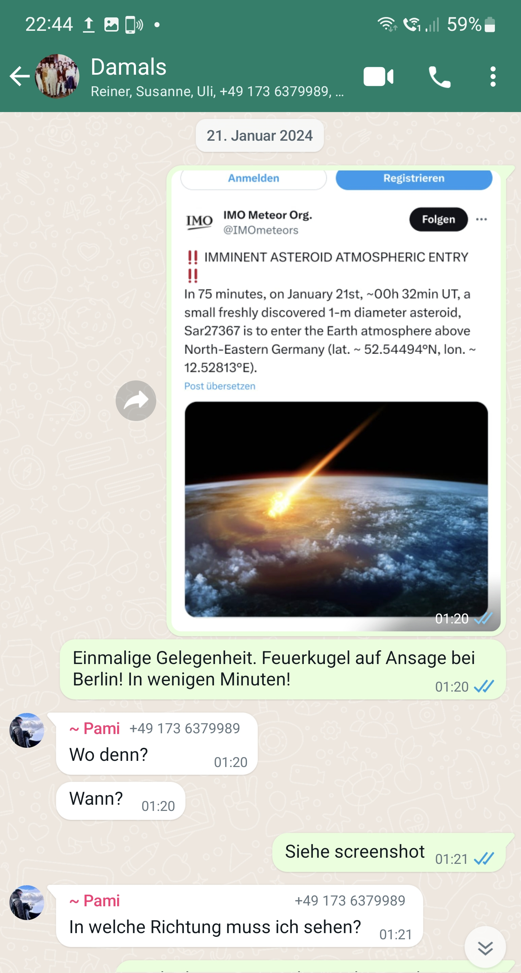
The Alerting
21.01.24, 01:16 Alerting the AKM WhatsApp group … W. Hamburg and P. Lindner see the fireball, among others.
21.01.24, 01:20 Alerting my daughter Laura – wake up your mother immediately and move outside … both witness the fireball.
21.01.24, 01:20 WhatsApp message to my family … my nephew witnesses the fireball.
21.01.24, 01:20 Alerting some former classmates in Berlin. No time for long explanation … they miss the event.

Slide 8
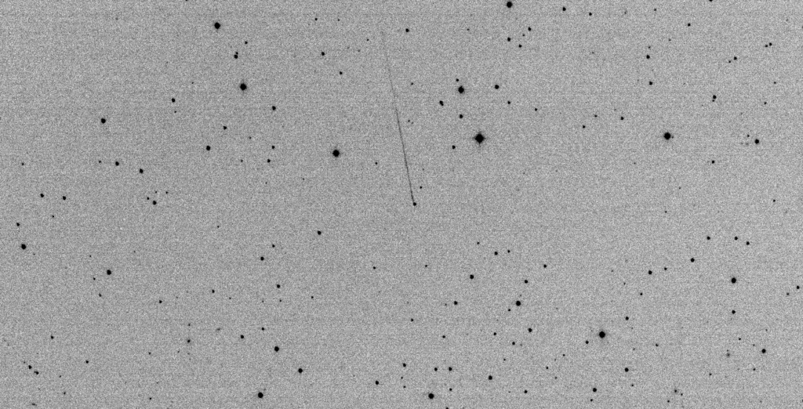
The Observation
21.01.24, 01:25 L. Buzzi from Schiaparelli Observatory in Italy obtains the last recording of the asteroid before it enters the Earth shadow within 10s.

Slide 9
The Alerting
21.01.24, 01:27 Alerting the AllSky7 mailing list … nobody is still awake.
21.01.24, 01:28 Short “Thanks You” to P. Jenniskens by mail. ☺
21.01.24, 01:29 Alerting the astro-Berlin mailing list … nobody is still awake.
21.01.24, 01:29 P. Jenniskens tells me that the fireball may also be visible from Bavaria.
21.01.24, 01:30 I enter my bathroom and look out of the window in northern direction …

Slide 10
The Observation
21.01.24, 01:32:43 IMPACT!

Slide 11
The Observation
View from South-East: AMS88 in Hoyerswerda (P. Lindner)

Slide 12
The Observation
View from North: AMS30 in Demmin (W. Hamburg)

Slide 13
The Observation
View from West: AMS213 in Wolfsburg (J. Lanz-Kröchert)

Slide 14
The Observation
View from East: AMS22 in Lindenberg (A. Knöfel)

Slide 15
The Observation
View from below: AMS16 in Ketzür (S. Molau)

Slide 16
The Observation
View from below: AMS16 in Ketzür (S. Molau)

Slide 17
The Observation
View from below: AMS16 in Ketzür (S. Molau)

Slide 18
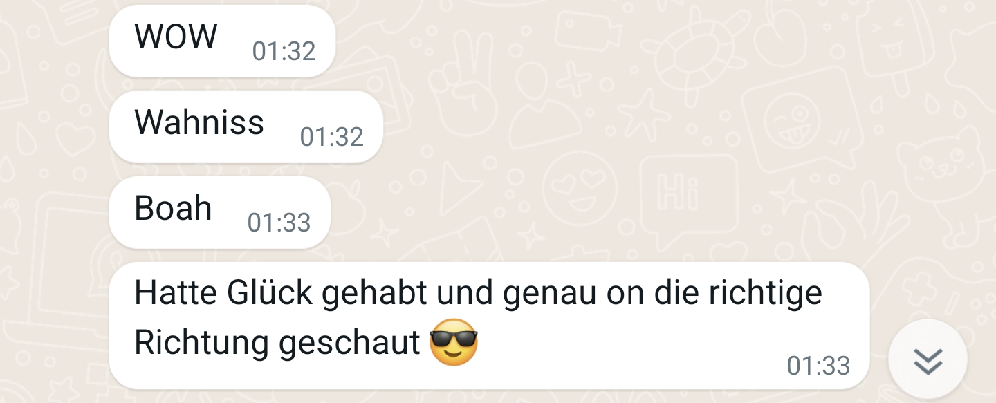
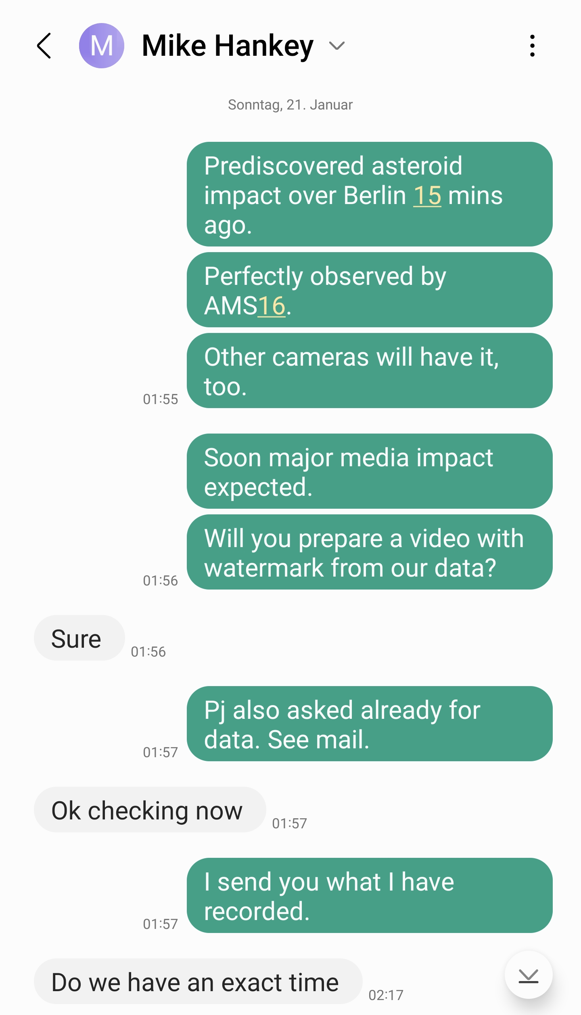
The Organization
21.02.24, 01:33 I have not seen anything.
21.02.24, 01:33 First visual confirmation reach my smartphone.
21.02.24: 01:43 Mail by P. Jenniskens: We'll need a trajectory asap.
21.01.24, 01:51 I have checked the recordings of AMS16: Direct hit!
21.01.24, 01:55 SMS to Mike Hankey: We got it! Houston, pls. take over …
21.01.24, 01:59 Request by André: Are we allowed to share the recordings?

Slide 19
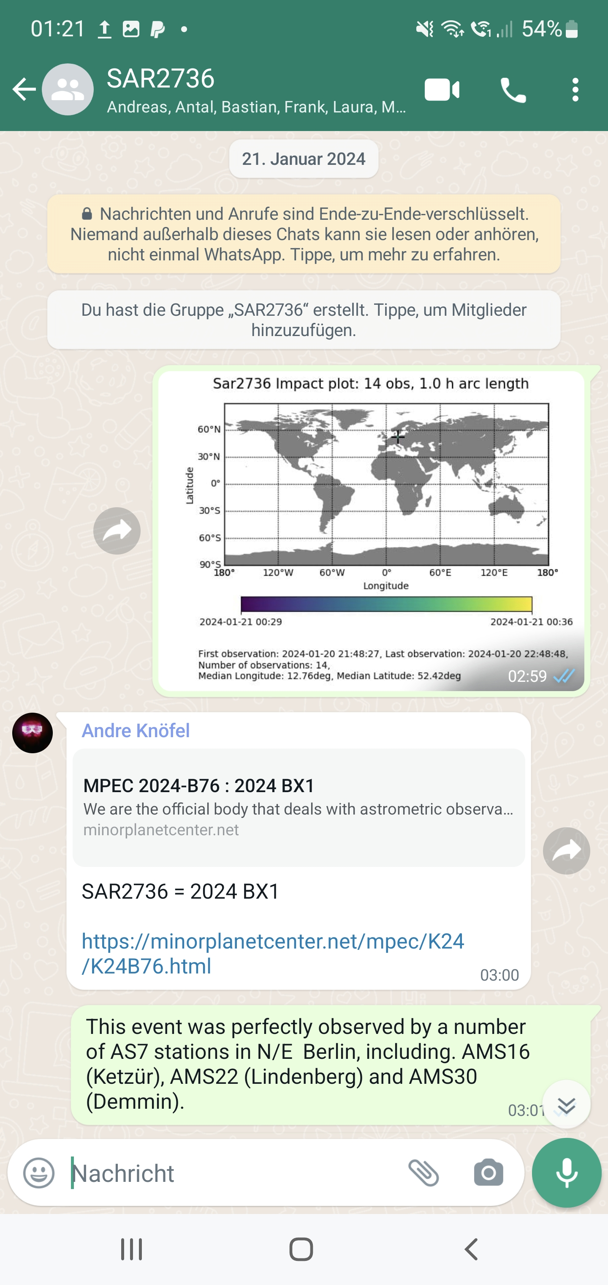
The Organization
21.01.24, 02:24 Mail by P. Jenniskens: Is it feasible to do a group search with 10-12 people? Looking into whether it makes sense for me to come out. Earliest I can be in Berlin is Monday morning.
21.01.24, 02:54 Congratulation by mail to the discoverer Krisztián Sárneczky.
21.01.24, 02:59 I create the WhatsApp group “SAR2736” and invite first members.
21.01.24, 03:07 Last mail … I go to bed.

Slide 20
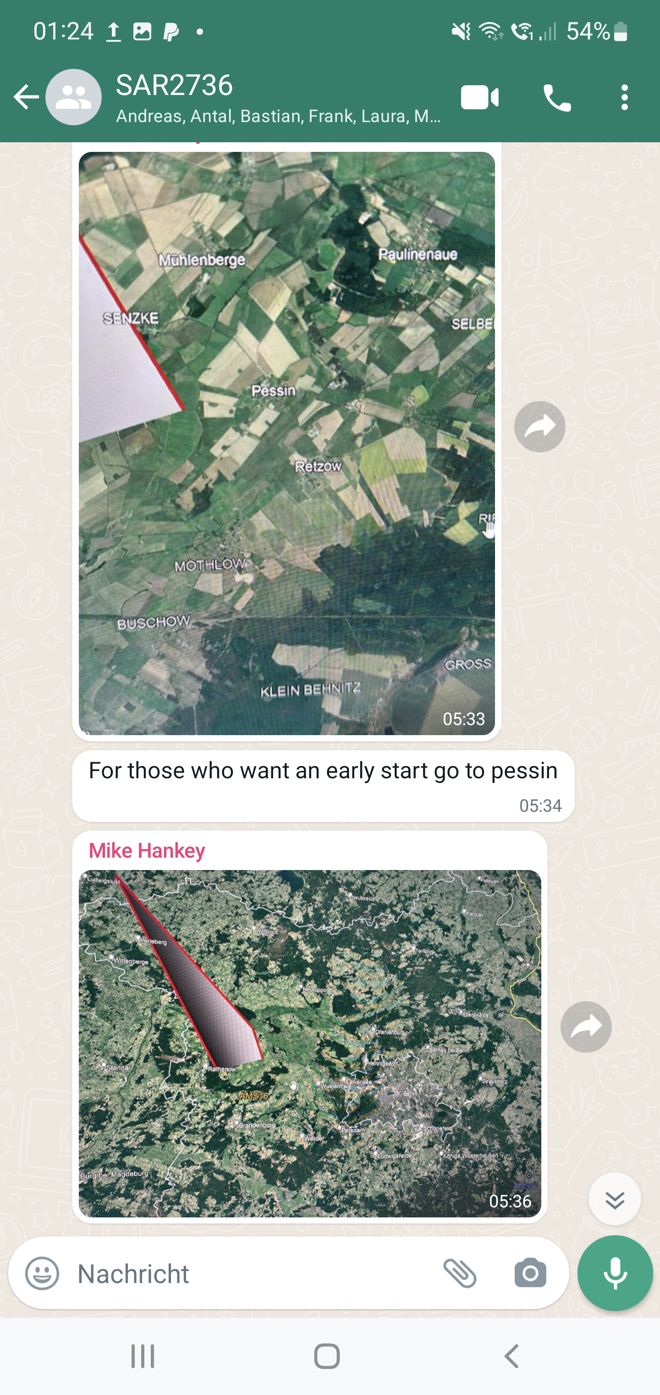
The Organization
21.01.24, 09:30 I wake up and check my smartphone. Mike has sent first calculations.
21.01.24, 09:31 I‘m petrified again: Meteorites in my front garden (… almost)!
21.01.24, 09:53 While taking a shower a decide to start immediately. Meeting at 3 pm onsite.
21.01.24, 10:15 I sit in my car at take breakfast while driving.
21.01.24, 10:59 Möthlow is decided as meeting point and communicated in the group.
21.01.24, 11:30 Phone calls to a number of AKM members to find brothers-in-arms.

Slide 21
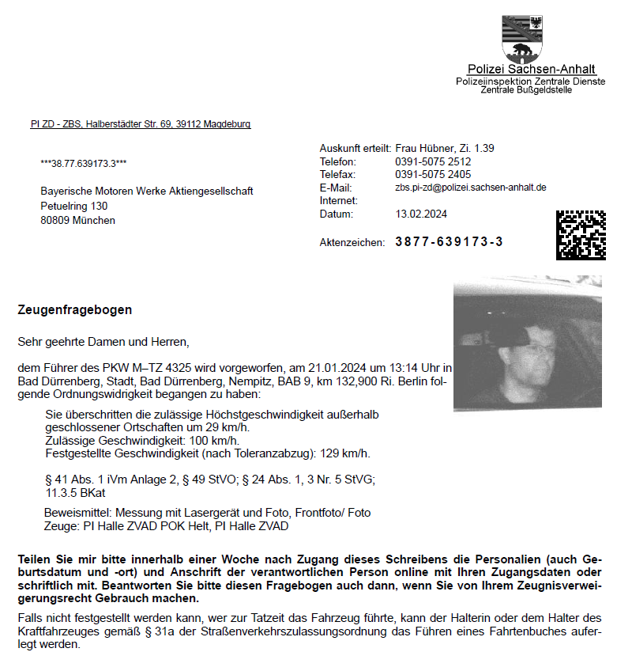
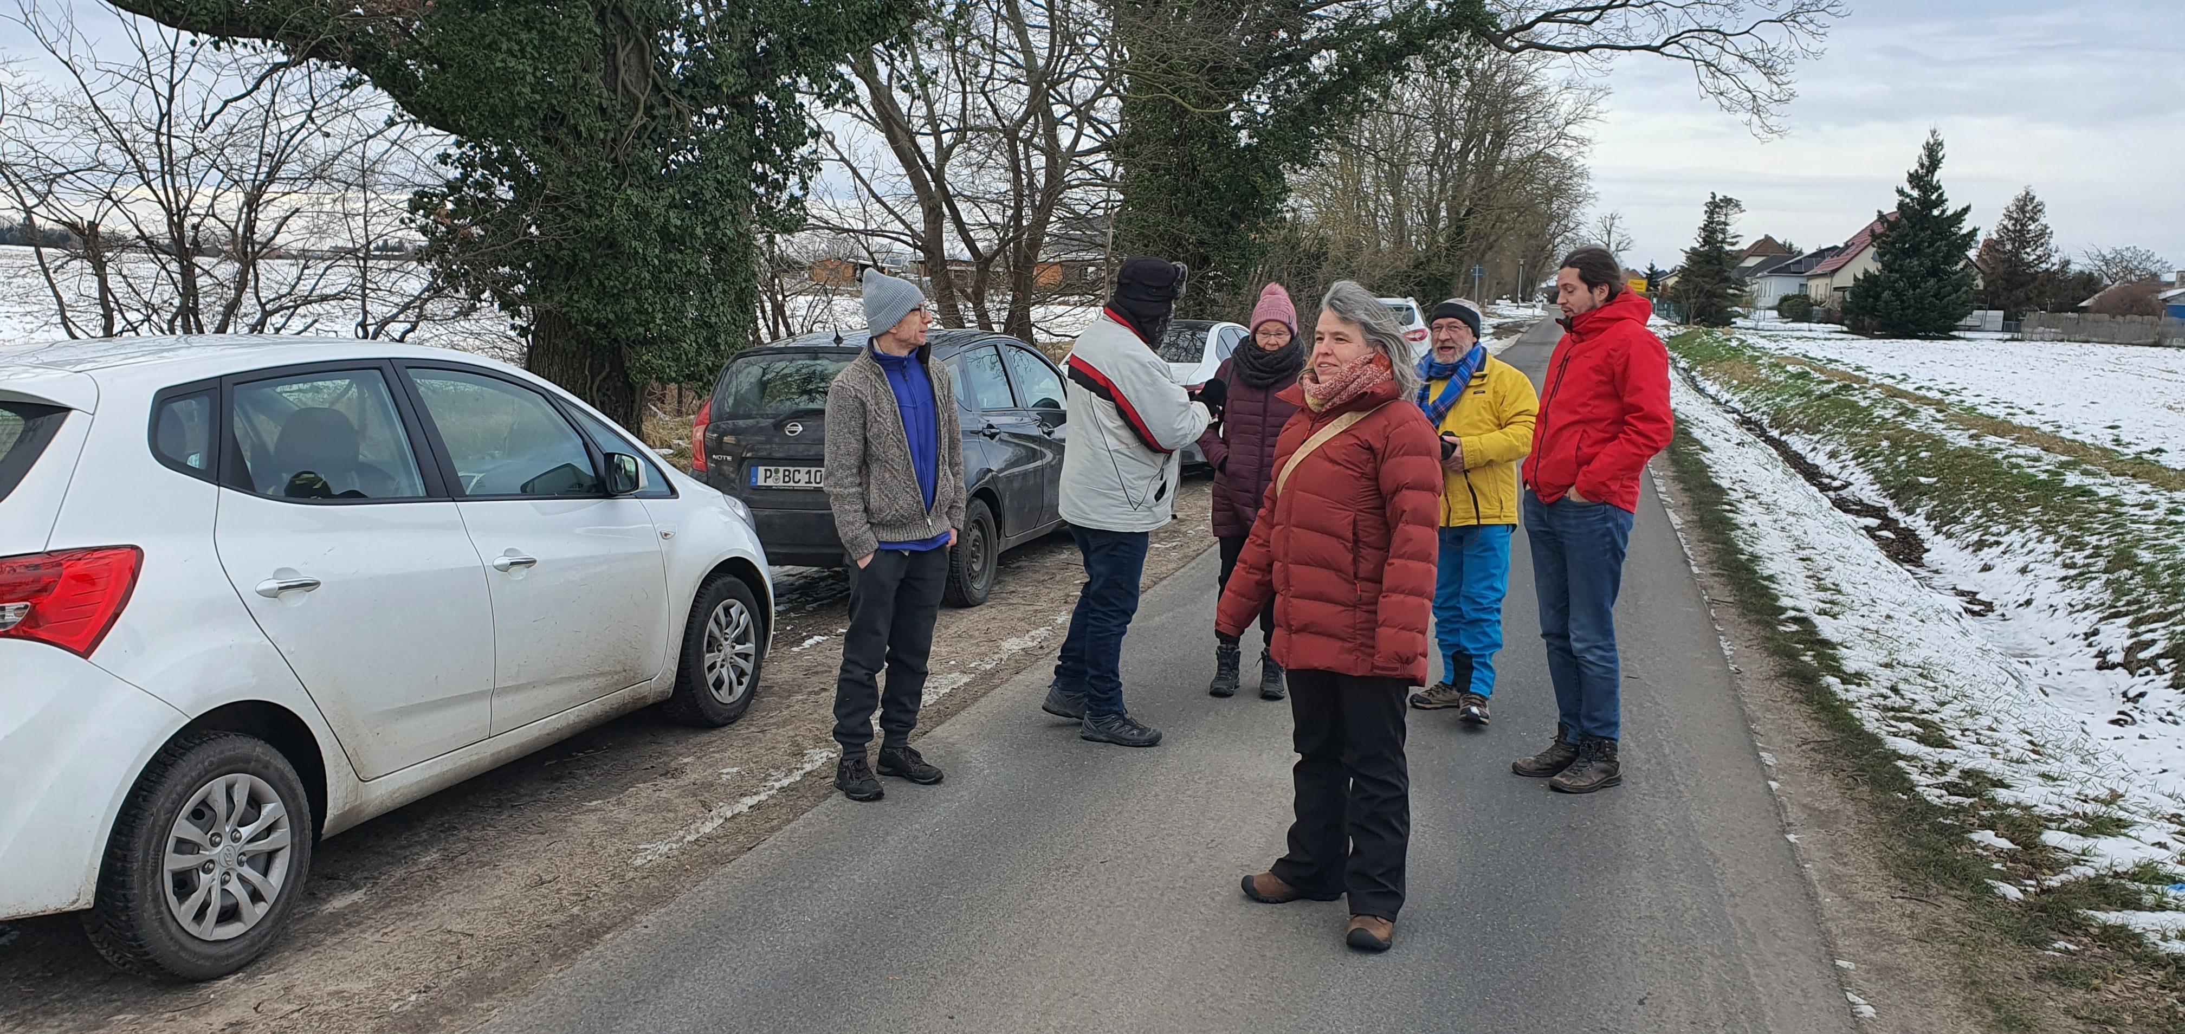
The Organization
21.01.24, 13:10 Taking gas at A9 hwy.
21.01.24, 13:14 Incoming call while entering the motorway. I‘m distracted and miss the speeding trap alert… ☹
21.01.24, 14:59 Arrival at Möthlow after a 550 km drive. A small AKM team is waiting already.
21.01.24, 15:10 Andreas arrives from far away (Berlin). ☺
13h 38m after the impact we start the search!

